Slide 1
MINOR PROJECT
COVID 19 Analysis and Predictions Using CNN
Mayank Aggarwal (189302045)
Vanshika Mediratta (189302025)
Mentor - Dr Nripendra Narayan Das

Slide 2
INTRODUCTION
Coronavirus disease 2019 (COVID-19) is a contagious disease caused by severe acute respiratory syndrome coronavirus 2 (SARS-CoV-2). The first case was identified in Wuhan, China, in December 2019. After that in 2020, the virus started spreading across the world affecting everybody and resulting in depletion in many other things like the economy, living conditions, obstruction in development, etc. COVID-19 has become the hot topic of the decade and analysis and prediction can benefit in discovering new patterns and trends in reports gathered through various international sources and even enforce precautionary measures for the future. The goal of this project is to look into some specific trends and patterns with the help of various upcoming Deep Learning Algorithms which can open the gate of discoveries and findings. The major Deep Learning Algorithm which will be used and implemented is CNN (Convolutional Neural Networks) which can take in an input image, assign importance (learnable weights and biases) to various aspects/objects in the image, and be able to differentiate one from the other.

Slide 3
INTRODUCTION
Current way of testing while very useful is very time taking. While researchers are trying other methods, some found that the chest X-ray of a person with COVID had some distinct features from that of a person infected with Pneumonia and those who had no diseases. It could hence also be able to predict whether a person has COVID or not.

Slide 4
Motivation
COVID-19 pandemic has affected all of our lives in the worst possible manner. If we could use our knowledge in the best possible manner and incorporate it with this project, we believe it could lead to some answers on this global issue. We also want to use our Machine Learning skills and refine them so that in future we could do projects with better efficiency.

Slide 5
Project Objective
● Objective is to visualize, clean and model the algorithm to give out the best possible and accurate result.
● We could apply this result to further deepen our understanding of the disease by performing deep learning algorithms like CNN for classification of a healthy and infected lung.

Slide 6
Methodology / Planning of Work
● We plan on researching the use of ML with predicting Coronavirus based on research papers.
● Studying about CNN, deep learning and various applications of this.
● After acquiring enough knowledge, the next step is finding the dataset for the project.
● We then study the features as well as X-ray images to get an understanding of what the project expects.
● We then perform exploratory data analysis to visualise the minute details and get a better understanding of the data.
● Data cleaning is done to remove any outliers present and avoid overfitting or underfitting and perform data augmentation.
● Train our CNN model with accurate layers and repeat the process until best accuracy is obtained.
● Use the model on test data to get results.

Slide 7
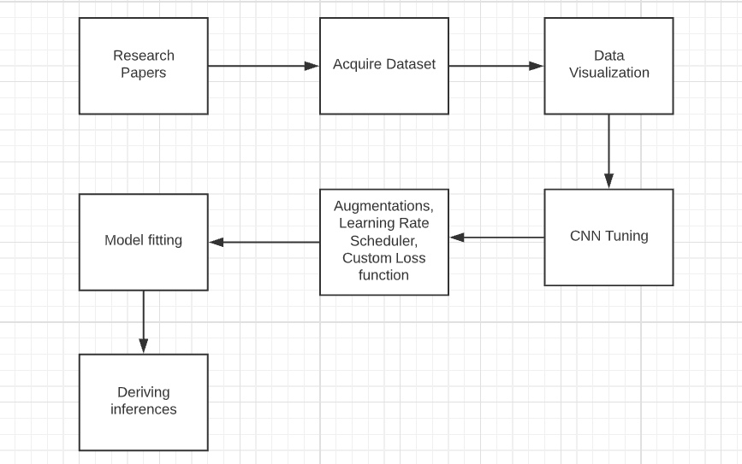

Slide 8
Research Paper
EMCNet: Automated COVID-19 diagnosis from X-ray images using convolutional neural network and ensemble of machine learning classifiers - Prottoy Saha *, Muhammad Sheikh Sadi, Md. Milon Islam Findings: four ML classifiers were combined to develop an ensemble of classifiers, which ensures better results for the dataset of various sizes and resolutions The models were trained and tested with a dataset of 1320 images where recent developing systems have conducted their research with comparatively small COVID-19 datasets. The model showed excellent performance with 98.91% accuracy, 100% precision, 97.82% recall, and 98.89% F1-score.

Slide 9
Research Paper
Automatic COVID-19 Detection from X-Ray images using Ensemble Learning with Convolutional Neural Network AMIT KUMAR DAS, SAYANTANI GHOSH, SAMIRUDDIN THUNDER , ROHIT DUTTA , SACHIN AGARWAL and AMLAN CHAKRABARTI Findings: three state-of-the-art deep learning models have been adopted and ensembled. The proposed model has achieved a classification accuracy of 95.7%. Even more important fact is it has given a sensitivity of 98%.

Slide 10
Research Paper
COVID-19 Prediction and Detection Using Deep Learning - Moutaz Alazab, Albara Awajan, Abdelwadood Mesleh, Ajith Abraham, Vansh Jatana, Salah Alhyari Findings: A diagnosis model using VGG16 was proposed to detect COVID-19 using chest X-ray images. The model allows the rapid and reliable detection of COVID-19, enabling it to achieve an F-measure of 99% using an augmented dataset. In a future study, we will consider diagnosing COVID-19 in chest CT scan images using the VGG-XX versions and compare their performances using larger datasets.

Slide 11
Datasets
There are two datasets used in this research work, one for the Data Visualisation part with the help of Tableau (by Salesforce) and the other one is for the CNN trained model for which Python is used -
Our World in Data - https://ourworldindata.org/coronavirus-source-data
Kaggle - https://www.kaggle.com/tawsifurrahman/covid19-radiography-database

Slide 12
Dataset - For Data Visualisation
The dataset being used for Data Visualisation and Analysis is OWID (Our World In Data) which is a scientific online publication that focuses on large global problems such as poverty, disease, hunger, etc. This dataset contains tuples of about 80,000+ which gets updated on a daily basis, and the set is time-series data for the countries in the world (193), provided with their population and population density as well. The important attributes of this dataset that have come to our use are the daily report on the covid19 cases, deaths, tests done, and vaccinations.

Slide 13
Dataset - For CNN Model
The dataset being used for training purposes it the COVID-19 Radiology Dataset from Kaggle. The dataset comprises of 3 classes of chest X-rays namely: Normal, Viral Pneumonia and COVID-19. The total number of X-rays available for COVID is: 3616 , Viral Pneumonia : 1346 and 10,192 Normal X-rays. developed the database of COVID-19 x-ray images from the Italian Society of Medical and Interventional Radiology (SIRM) COVID-19 DATABASE , Novel Coronavirus 2019 Dataset developed by Joseph Paul Cohen and Paul Morrison, and Lan Dao in GitHub [2] and images extracted from 43 different publications. Some sample data is shown in the next three slides -

Slide 14
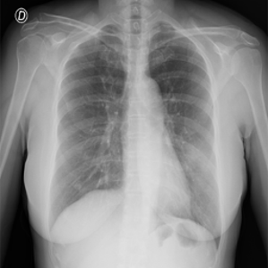
COVID - 19 Lung X-Ray

Slide 15
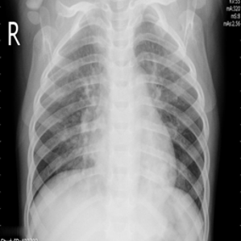
Viral Pneumonia Lung X-Ray

Slide 16
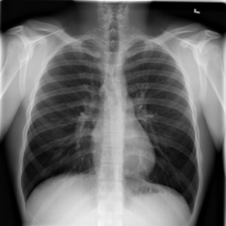
Normal Lung X-Ray

Slide 17
Data Visualisation
Data Visualization is a graphical representation of data using charts, graphs, tables, and maps, etc. This technique is imperative as it allows us to see the trends and patterns in the data more clearly and effectively, which results in a better understanding of the data. These data visualization tools and techniques come to use even more when dealing with Big Data to analyze it and make data-driven decisions. In this study of Covid19, the software used for Data Visualization in Tableau. As far as Covid19 is concerned, it is very important to know the status of the spread factor across the world before moving ahead towards getting a conclusion with the help of the CNN Model.

Slide 18
Spatial Analysis
Spatial analysis includes any of the formal techniques which studies entities using their topological, geometric, or geographic properties. Here we have done it on three parameters -
Total Confirmed Cases
Total Deaths
Total Vaccinations

Slide 19
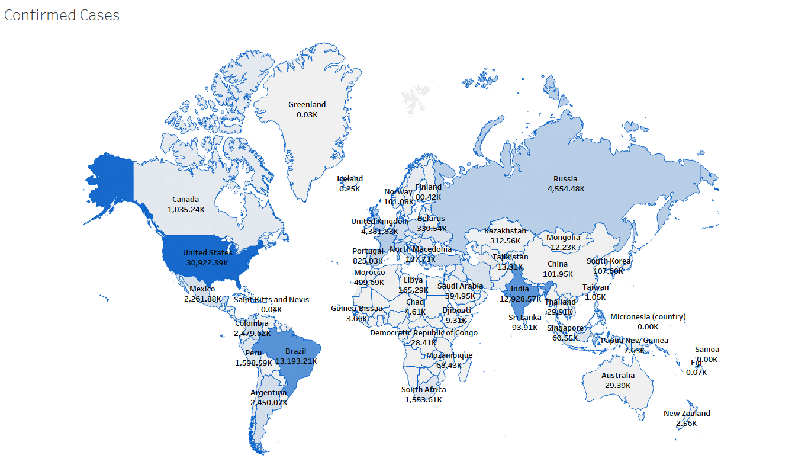

Slide 20
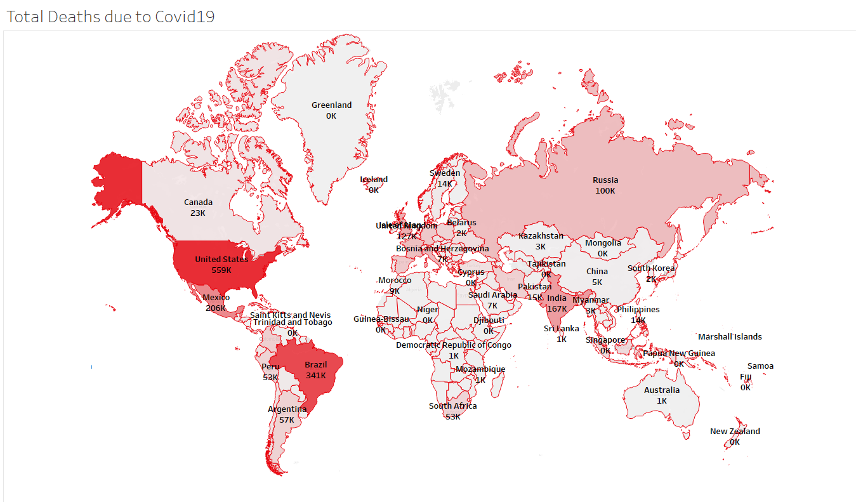

Slide 21
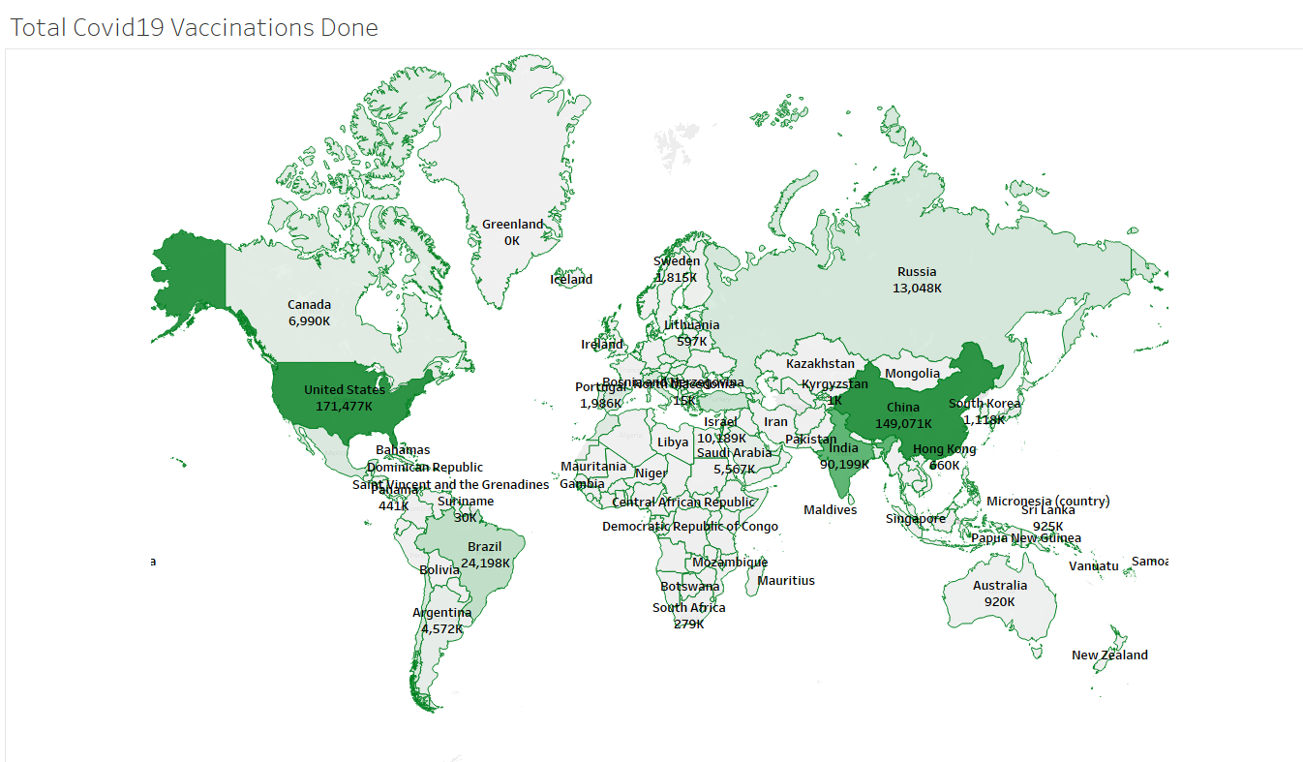

Slide 22
Time-Series Analysis (Continent-Wise)
Time series analysis is a statistical technique that deals with time series data, or trend analysis. Time series data means that data is in a series of particular time periods or intervals. Here we have used this technique for 3 trends we could look for -
New Covid19 Cases
Comparison b/w New Cases and Deaths
Comparison b/w New Vaccinations and New Vaccinations per million

Slide 23
New Covid19 Cases
The graph shown in the next slide helps us visually analyze the Active Covid19 Cases trends for all the continents. From which we can clearly see that at the end of 2020 the cases were highest in Europe and North America. In Asia, there is a different kind of pattern to be seen in which in January - February 2021 the cases were dropping by a lot, but after March started, The cases in Asia has peaked never like before and it is still increasing as we speak. This increase in Asia currently indicates a second wave of Covid19 for which there could be many reasons like the Mutant State of Covid19 Traces, Lack of precaution, etc.

Slide 24
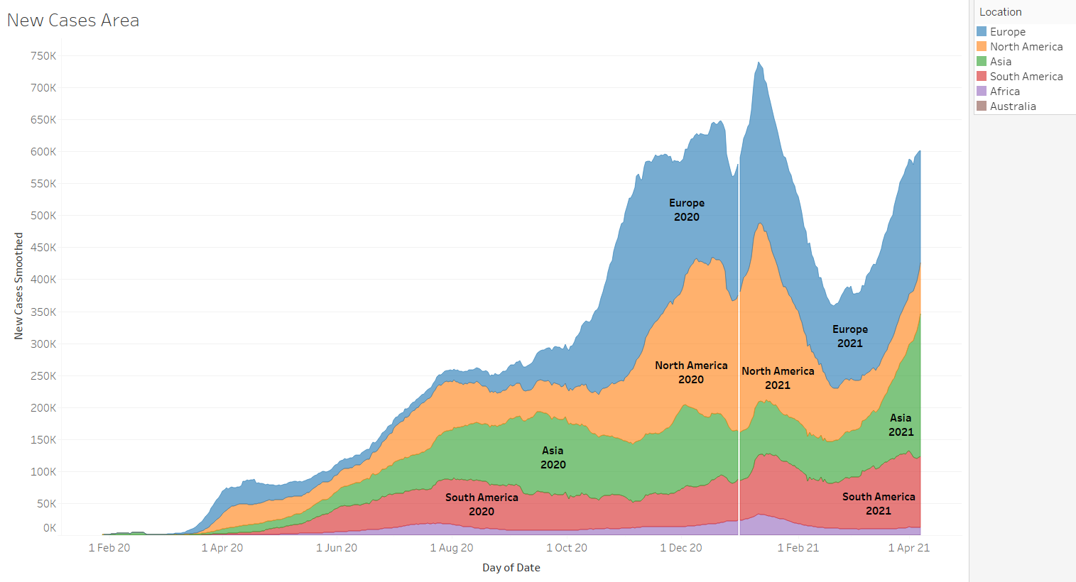

Slide 25
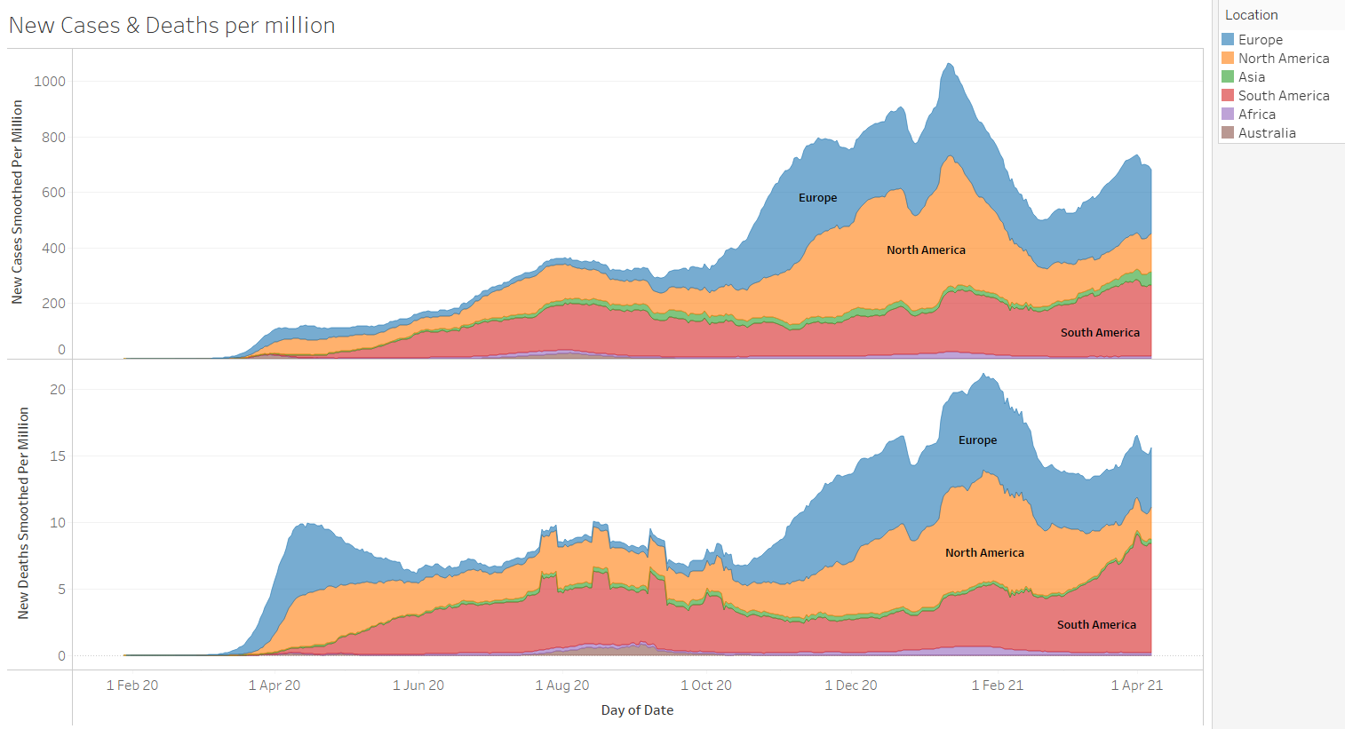

Slide 26
Comparison b/w New Vaccines & Vaccines per Million
The graph shown in the next slide helps us visually analyze the difference between New Vaccinations and New Vaccinations per million. From which you can observe like suppose for Asia, the increase in new vaccinations is drastic and has spiked even more since March 2021. But, if we take a look at New Vaccinations per Million then it comes 3rd to 4th among the six continents (Antarctica not included), this is due to the population in Asia is 456 crores, which is more than half of the world population. This means that the increase in vaccinations should increase even more to meet up with the population of the continent.

Slide 27
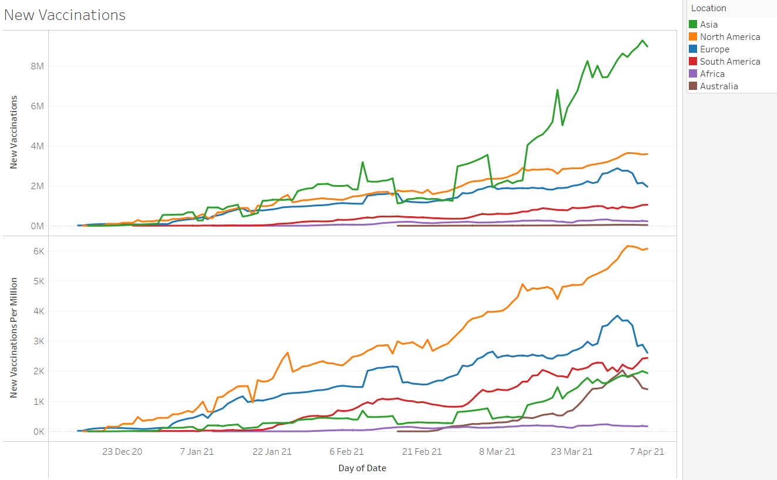

Slide 28
DATA AUGMENTATION
To increase the accuracy of the X-rays, we performed data augmentation techniques like using zooming in to the image by 10%, providing a shear range of 0.1 or 10% and performing vertical flips. This would enable the model to perceive the image as humans do.
The next slide has an example of these tasks:

Slide 29
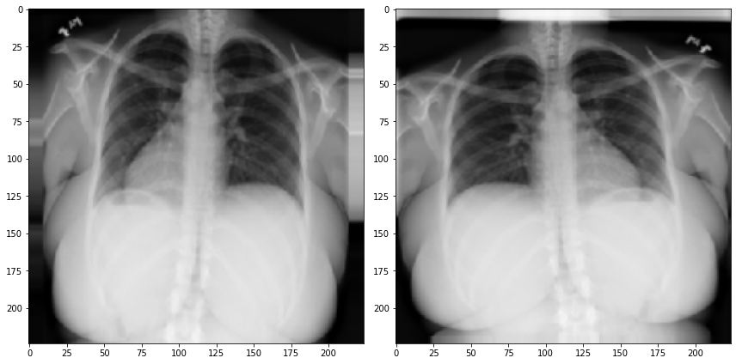

Slide 30
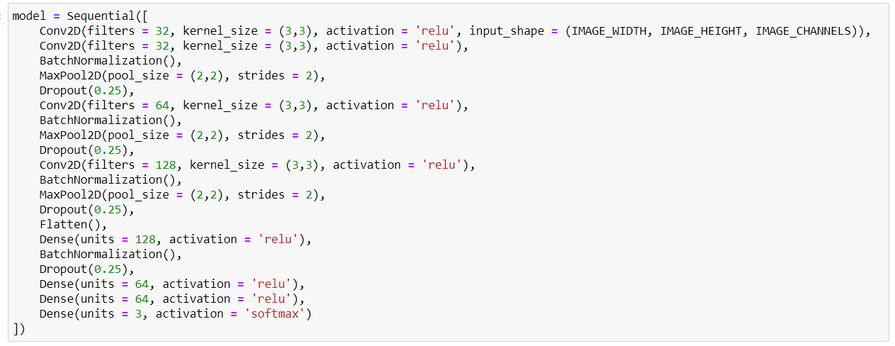
CNN Model - Architecture

Slide 31
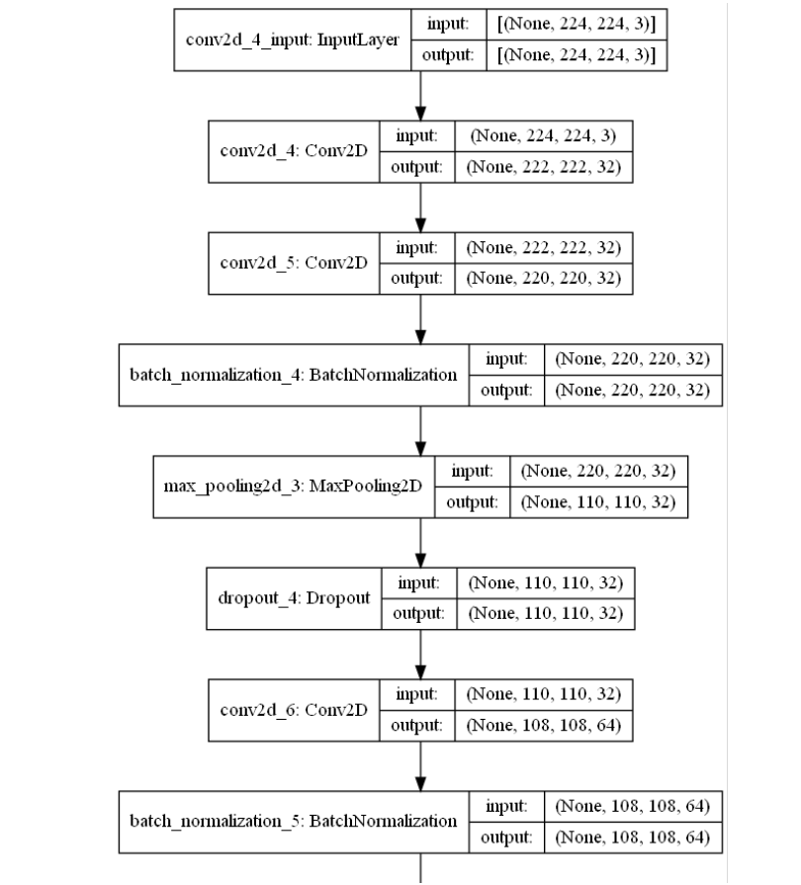

Slide 32
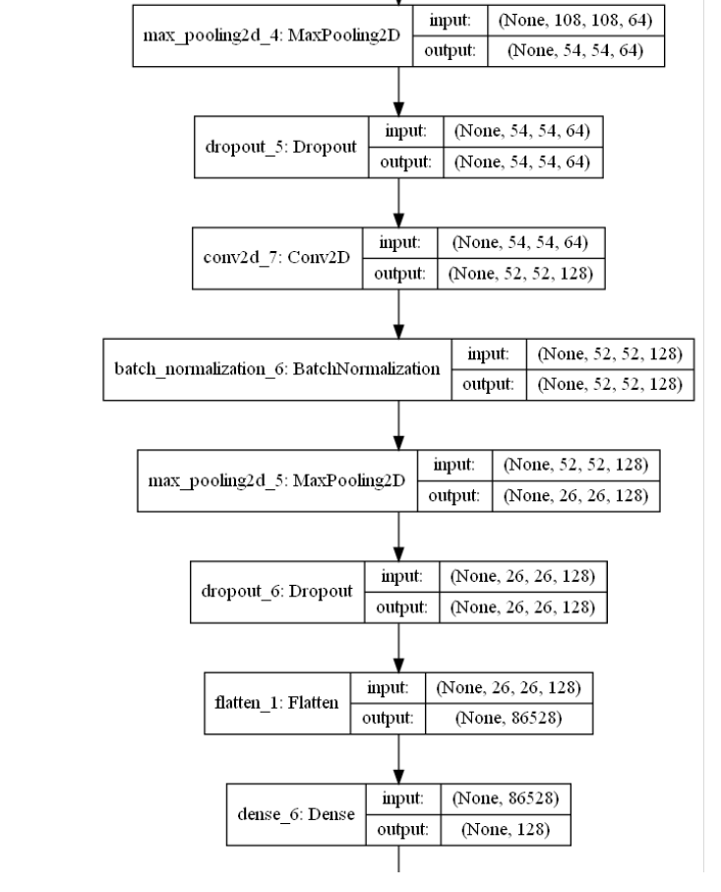

Slide 33
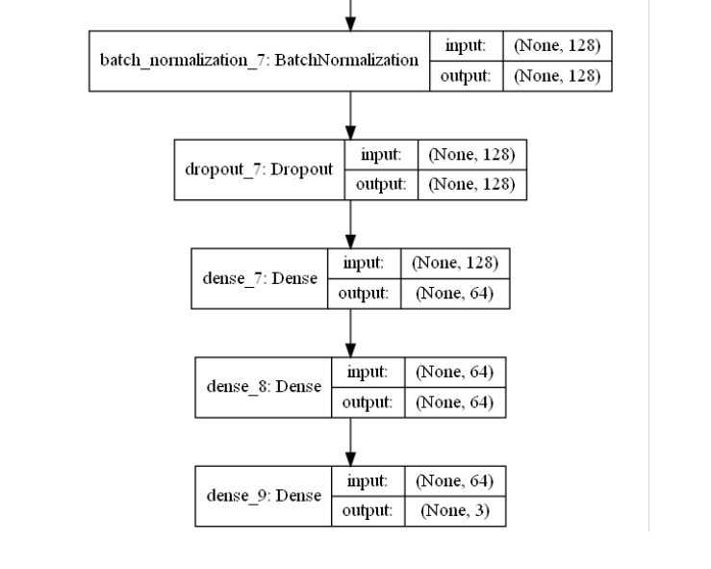

Slide 34
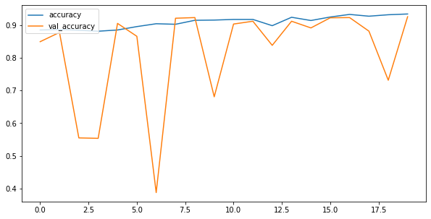
Accuracy at the moment

Slide 35
Conclusion
The accuracy at the moment with respect to the validation set is 92.61%. With better techniques, more advanced data augmentation and better layering, we are aiming for a higher accuracy.

